Slide 1
Downloading the Arduino programing software and running the programs

Slide 2
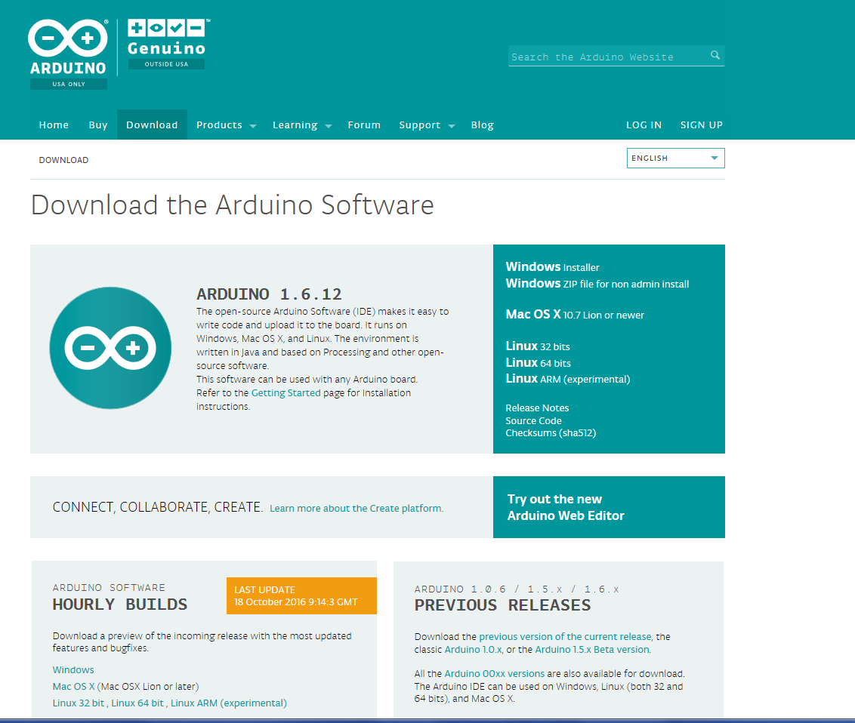
Installation
For windows click on windows. For mac click on mac. Follow the normal instruction for installation. Desire folder etc.

Slide 3
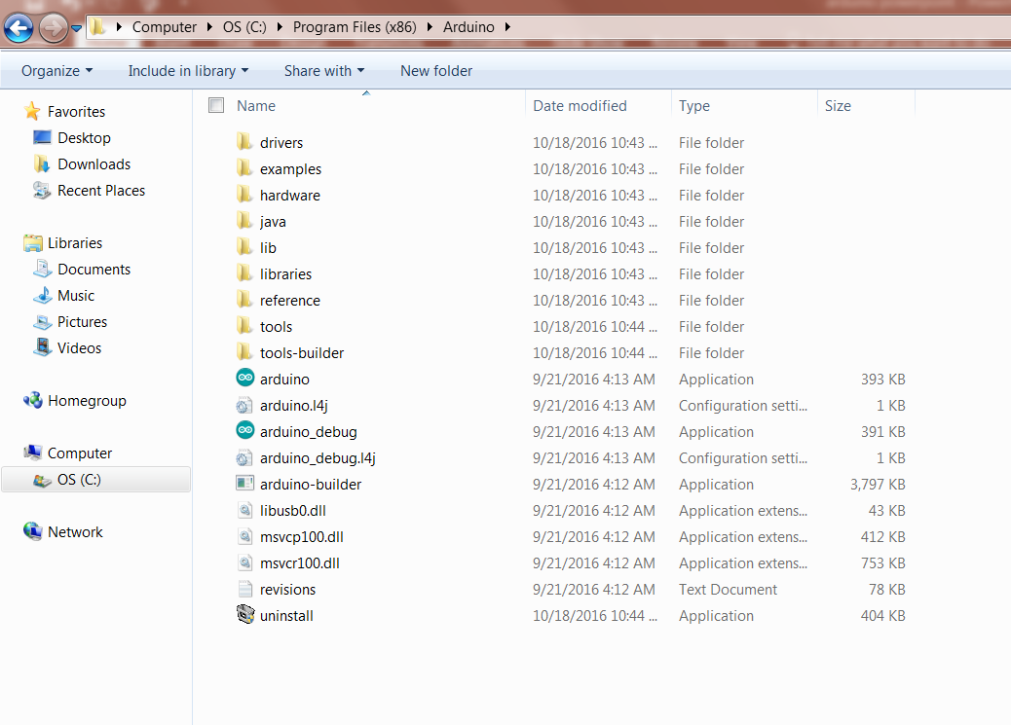
Installation
Go to the folder where you have installs Arduino. Click on Arduino to start the program

Slide 4
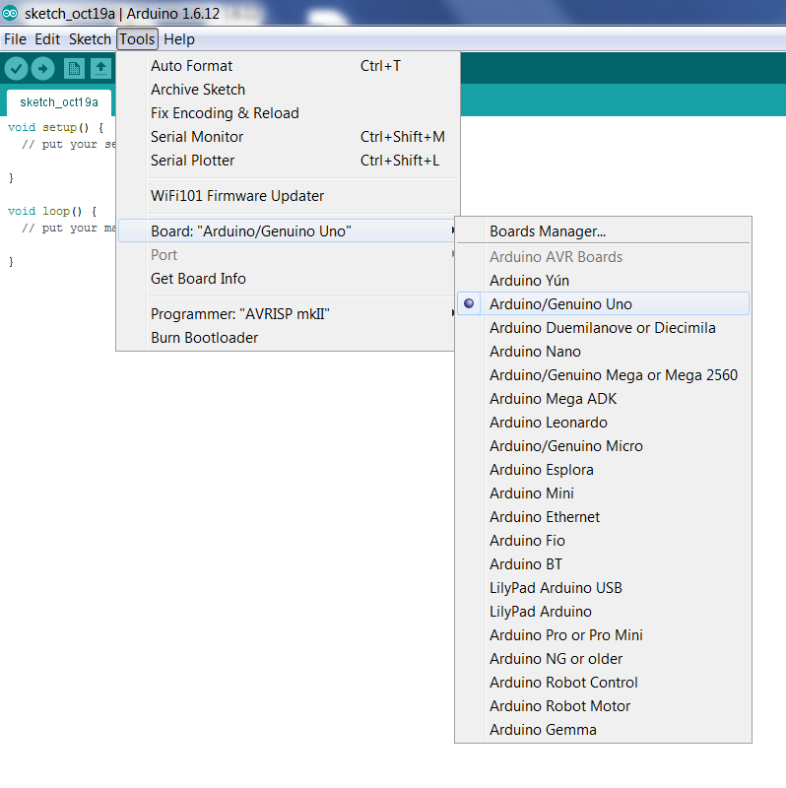
Connect
1. Connect the Arduino via the USB Cable.
2. In the Arduino window, select Tools > Boards > Arduino Genuiono Uno.

Slide 5
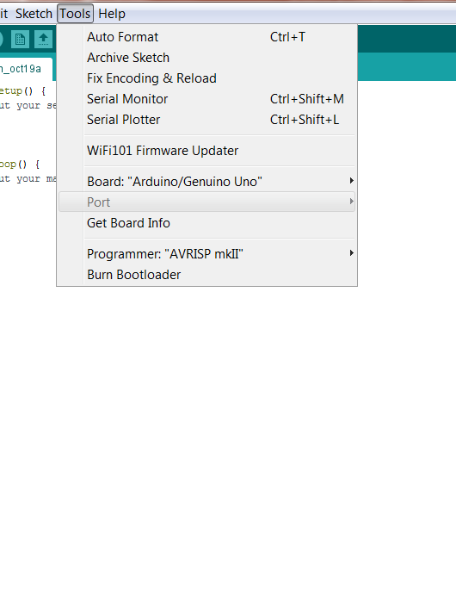
Connect
Then select Tools > Port > then select the board connected to the USB (typically COM4)

Slide 6
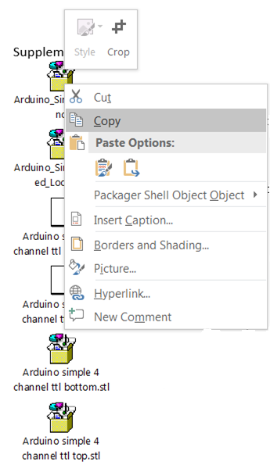
Obtaining files
Copy the sample files into a desire folder. Click on the file then right click and click on copy. Place the file in the desire folder. Repeat the steps for the rest of the files.

Slide 7
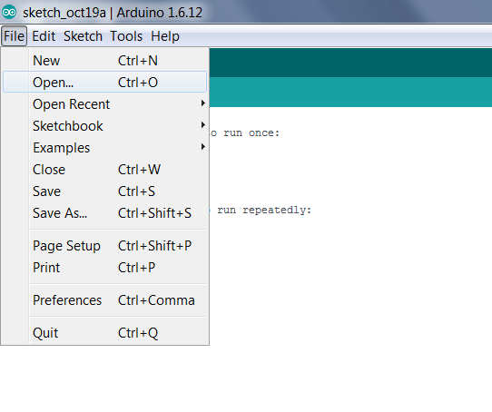
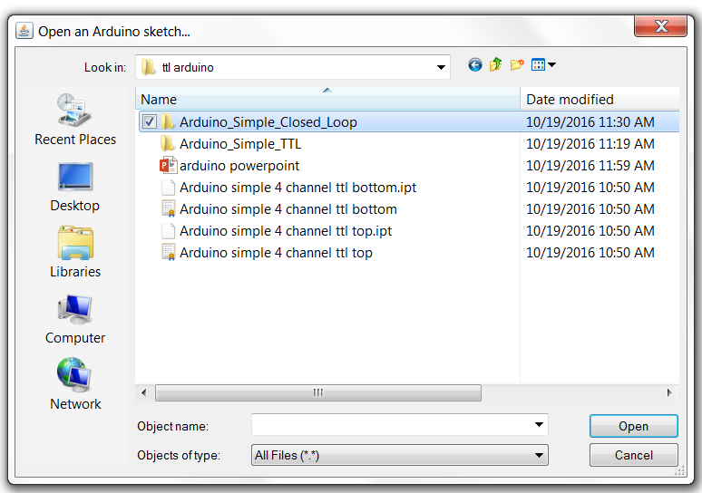
Open Files
Open the desire program by clicking File >Arduino_Simple_Closed_loop
Or any program you want to run.

Slide 8
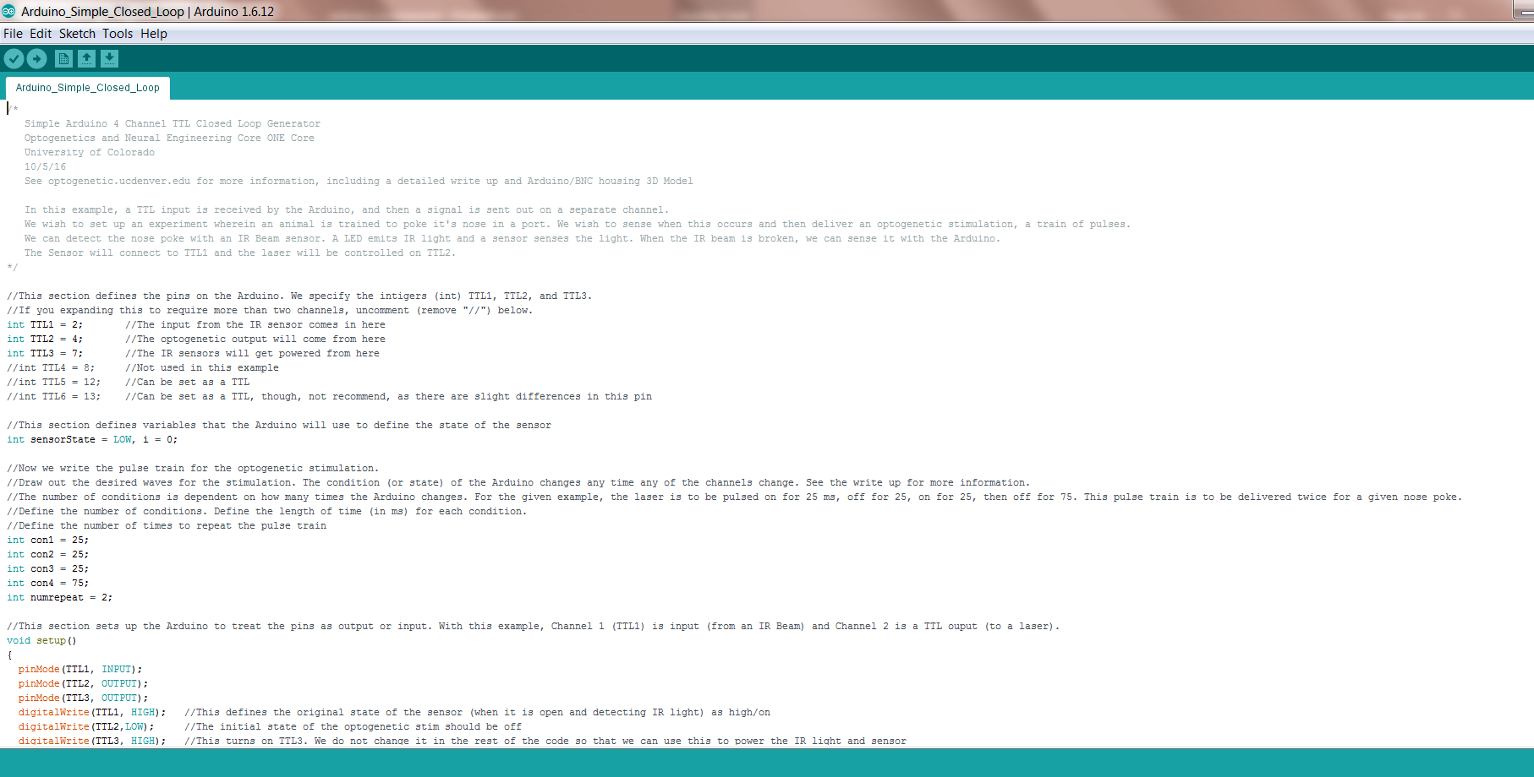
Verify the program
Once the program is open click on the check mark

Slide 9
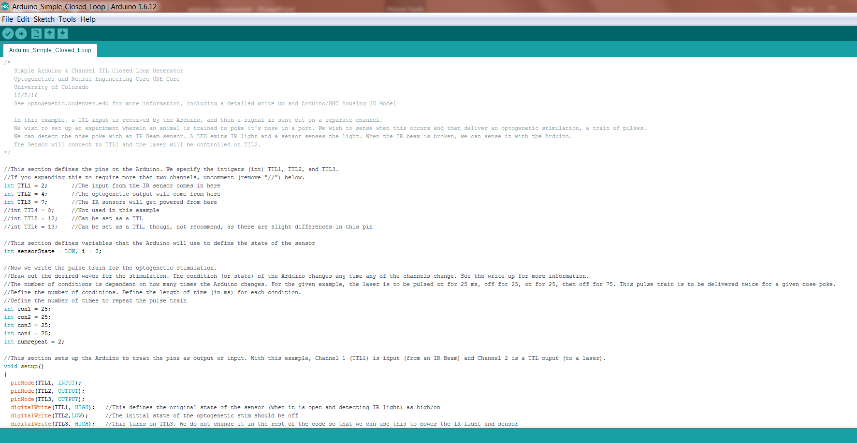
Upload the program to Arduino
Click on the arrow to run the program

